Slide 1
Green shipping as competitive factor – Zero Emission Ferries
Schwerin, 12.04.2013

Slide 2
AGENDA
Short introduction of Scandlines
Scandlines‘ Vogelfluglinie: Efficiency as a base for green shipping
Green shipping by technology:
  Hybrid drive + Scrubbers
  Zero Emission Ferries
4. Green shipping as the environmental-friendly alternative

Slide 3
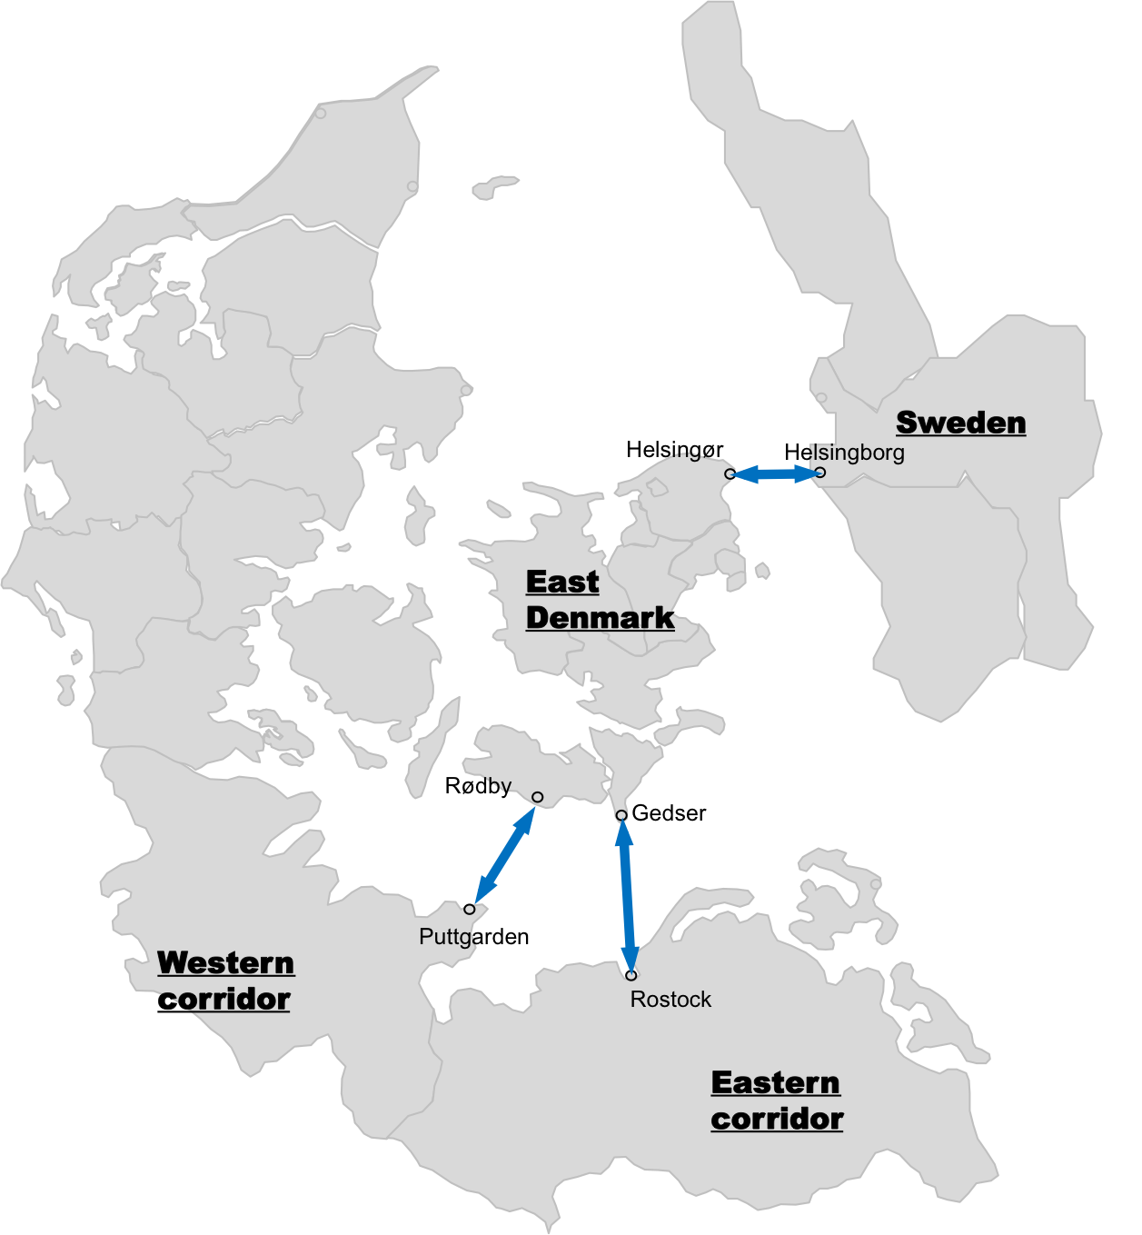

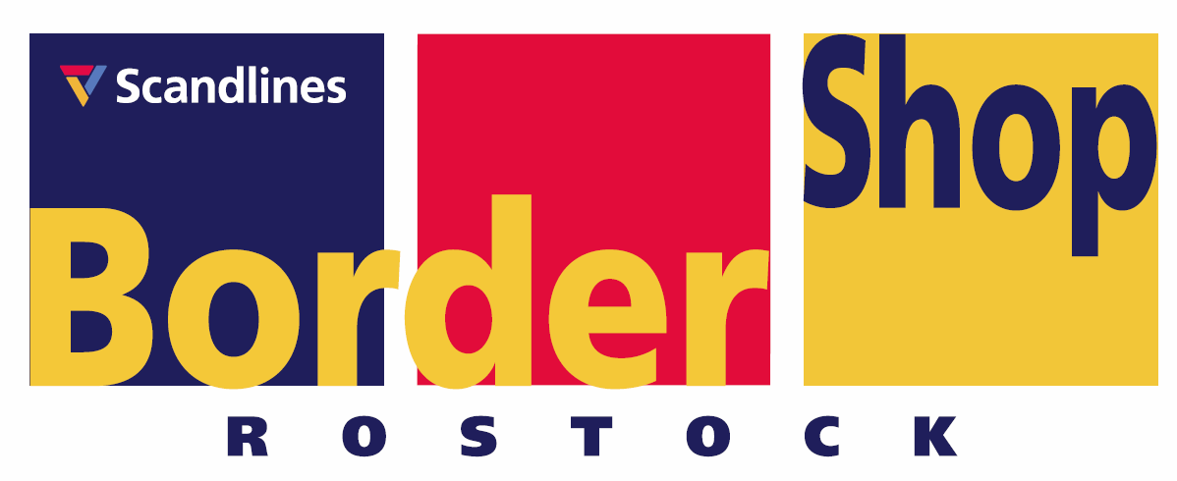
Scandlines is a vital part of the transport infrastructure connecting Scandinavia and the Continent
Scandlines facts
Danish-German company
Employees: 1.800
Turnover: 608m €.
3 ”Traffic Machines” offering high frequency and large capacity with crossing times less than 2 hours
Traffic Machines 2012 in figures:
  Passengers: 15 mill.
  Cars: 3,3 mill
  Trucks: 814.000
2 border shops in Rostock and Puttgarden

Slide 4

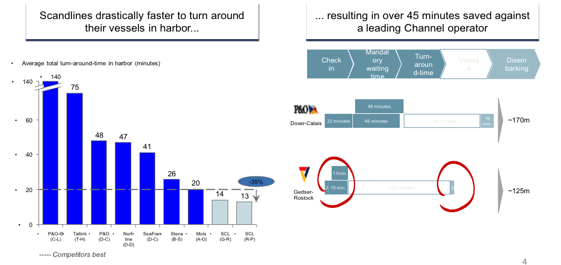
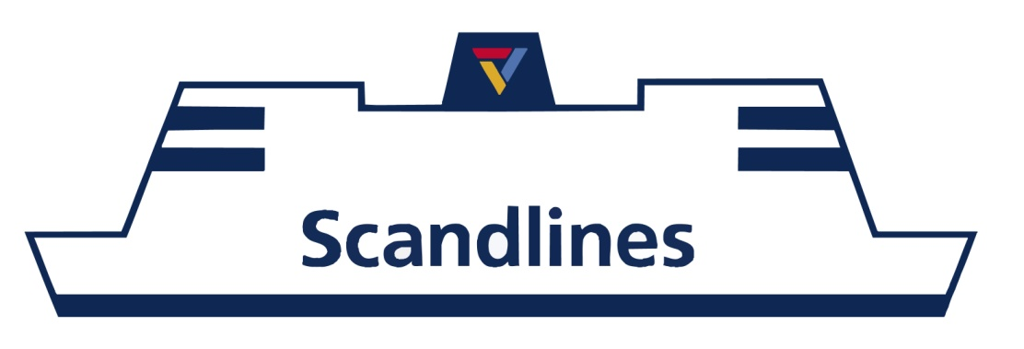
Scandlines‘ Vogelfluglinie: worldwide benchmark for highly-efficient short sea shipping systems
Loading and unloading in less than 15 minutes
Port infrastructure
Service on board
Port service
Clear signposted access
Automatic Check-In
Railway track, ramps, exits optimized for fast turnover
Restaurants and Cafes
Rest zones, children’s corner
Perfume- and Travel-Shops
Bunker supply
Storage
Catering-supply
… operates 24/7, 365 days a year, departure every 30 minutes
Source: Study BCG

Slide 5
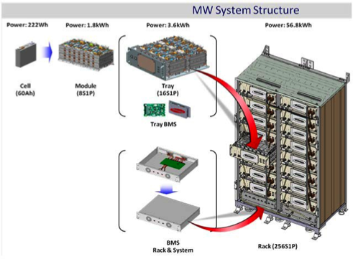
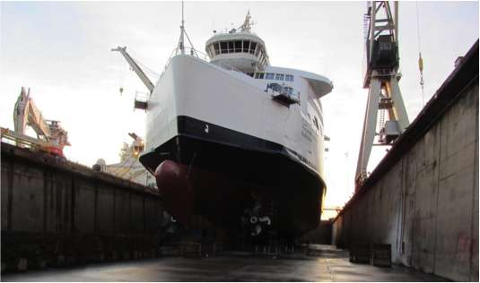
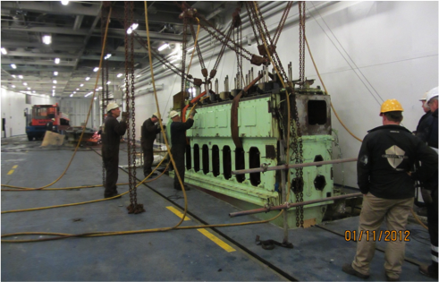
Technology for green shipping: Conversion of today‘s ferries on Vogelfluglinie (Pilot Project)
Retrofit of all 4 ferries:
Energy reduction measures
  Hybrid system and optimized propellers
  Fuel consumption/CO₂ emissions ↓ 20%
Installation of Scrubbers
  SO_{X} ↓ 99%, PM ↓88%, (CO₂ ↑)

Slide 6
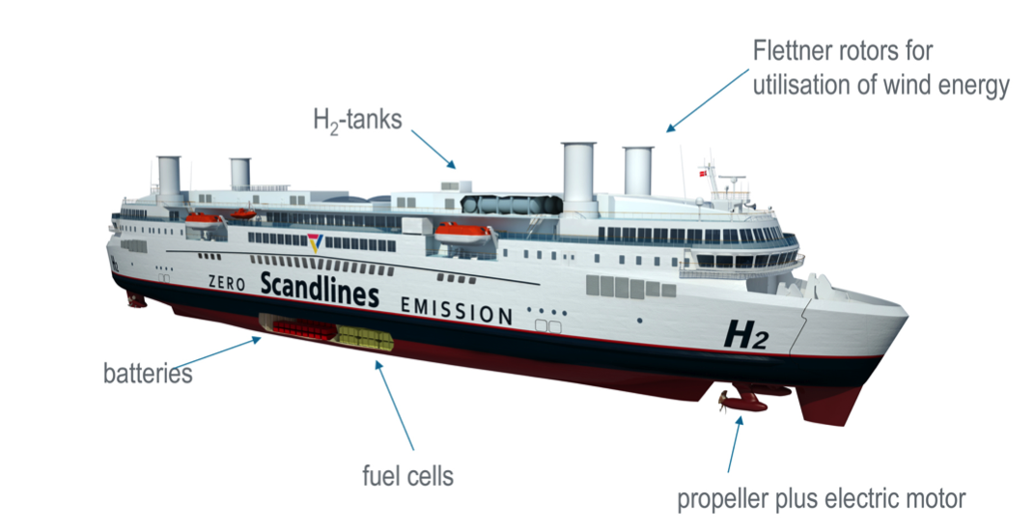
Technology for green shipping:
Zero-Emission-Ferries
Energy source
Energy carrier
Energy converter
Ø Consumption and
Emissions Present
per trip:
0.95 t Heavy fuel oil
2.96 t CO₂
0.10 t SO_{X}
0.05 t NO_{X}
Wind
Hydrogen → H2
Fuel Cell, Battery
Ø Consumption and
Emissions Future
per trip:
0.00 t Heavy fuel oil
0.00 t CO₂
0.00 t SO_{X}
0.00 t NO_{X}
Source: FutureShip GmbH

Slide 7
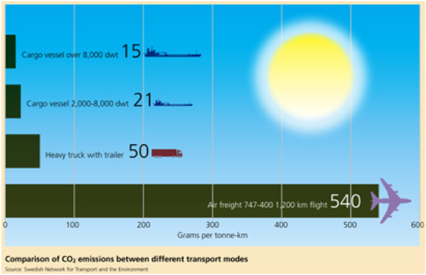
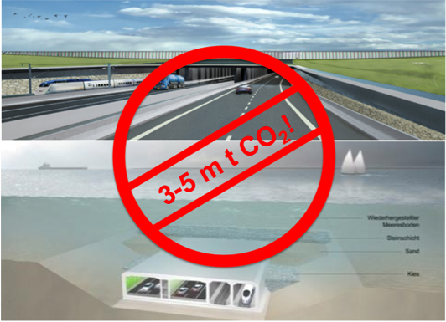
Zero Emission Ferry – a greener solution
Shipping is the most efficient means of transport!
By using green energy, Zero Emission Ferries further increase cost/benefit ratio of shipping
Political consensus to shift more freight from road to sea!
How do fixed links fit to that?
Fehmarn Belt fixed link:
Environmental impact: 3-5m t CO₂ during building phase (Grontmij 2011)
Significant CO₂ output by vehicles after opening
Source: NTM Sweden
Source: Femern A/S, Grontmij

Slide 8
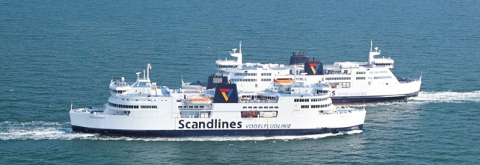
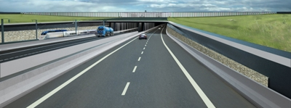
Ferry System vs. Fehmarn Belt Fixed Link
Cost/benefit improved ferry system:
Cost/benefit immersed tunnel:
Pic: Femern A/S
5,22
Evaluation 1999
Evaluation 2004
1,27
1,01
Source: PLANCO (2000): Economic Evaluation of an improved Ferry System, Final Report
Source: COWI/Planco (1999): Economic and Financial Evaluation of a Fixed Link
across the Fehmarn-Belt, Final Report
Source: COWI (2004): Economic Assessment of a Fixed Link across the Fehmarn Belt,
Summary Report
Fixed Link: Viable with state guarantees and EU funding only
Main benefits of Zero Emission Ferries:
Technical quantum leap for EU‘s maritime economy, role model for competitors
European yard sector gets boost
Technological innovation secured
Jobs in Germany and Denmark will be safeguarded
Private investment of 500m €
Zero Emission Ferries would have a positive business case, if fixed link will be postponed until 2030!

Slide 9
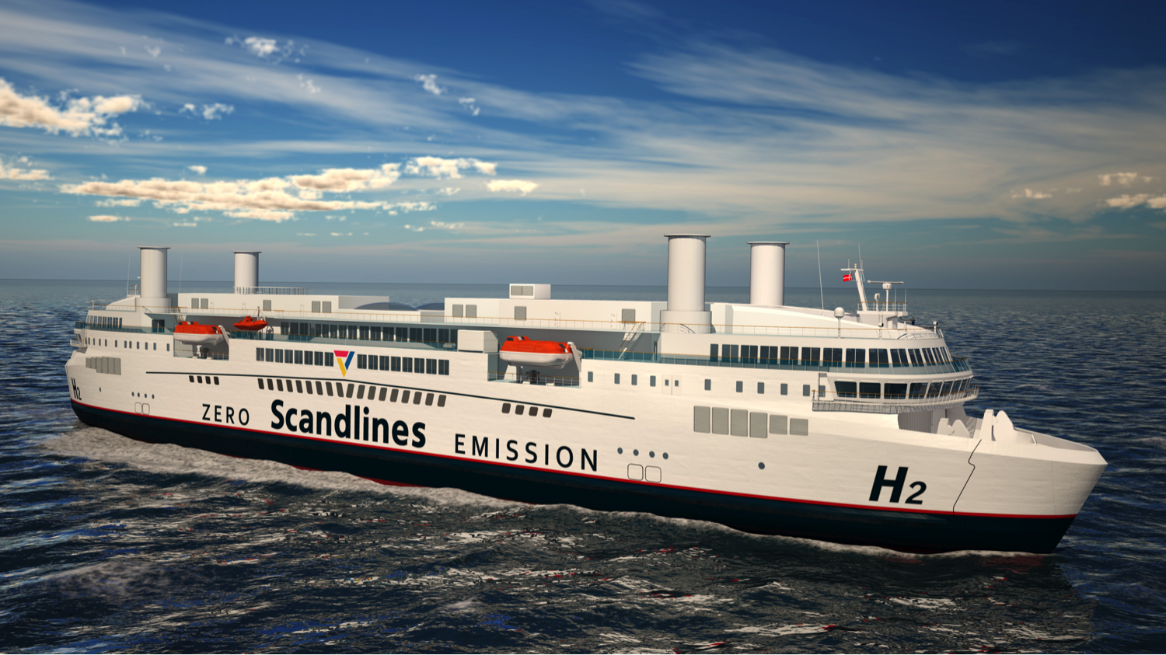
Is a green future possible by public funding only?
Dr. Gernot Tesch
Geschäftsführer
Scandlines Deutschland GmbH
Gernot.Tesch@scandlines.com

